Slide 1

Scheduling Jobs on a Supercomputer

Slide 2









Meet the User Support Team
Layla Freeborn
Brandon Reyes
Andy Monaghan
Michael Schneider
John
Reiland
Dylan Gottlieb
Mohal Khandelwal
Ragan
Lee
2

Slide 3

Website: www.rc.colorado.edu
Documentation: https://curc.readthedocs.io
Helpdesk: rc-help@colorado.edu
3

Slide 4

https://github.com/ResearchComputing/scheduling_a_job_on_a_supercomputer_rc_shortcourse

Slide 5


Ask Questions
Discuss Ideas
Notes:
This workshop is meant to be empowering and information-rich – to help you get the most out of your HPC workflow.
Feel free to ask questions during the presentations and to discuss ideas/thoughts during breaks and the hands-on portion of the workshop.

Slide 6
Session Overview
Overview of Jobs Submissions
Resource Requests
Interactive & Batch Jobs
Monitoring jobs

Slide 7

General Overview of Job Submission
1
Login Node
Notes:
A job submission consists of three general steps:
Log onto a CURC Login Node (ssh, OnDemand)
*Warning/Reminder*
Software cannot be accessed/run from a login node. You must run your applications from a compute node. But, in order to run on a compute node, you must first request the system resources through a ”job”

Slide 8

General Overview of Job Submission
1
2
Login Node
Job Request
Notes:
A job submission consists of three general steps:
Log onto a CURC Login Node (ssh, OnDemand)
*Warning/Reminder*
Software cannot be accessed/run from a login node. You must run your applications from a compute node. But, in order to run on a compute node, you must first request the system resources through a ”job”
2. Job requests are submitted to SLURM, our system’s Job Scheduler which manages how and when system resources are allocated to user submitted jobs.

Slide 9


General Overview of Job Submission
1
2
3
Login Node
Job Request
Job Queue
Notes:
3. Jobs do not run immediately but instead wait in a SLURM managed queue. A job’s placement in the queue is dependent on multiple factors. We will discuss a few of the most common factors, but a general rule to follow is that the more resources a job requests the longer it will wait in the queue.

Slide 10
General Overview of Job Submission
1
2
3
Login Node
Job Request
Job Queue
> Job Start <
Notes:
Once SLURM determines they system is ready, it will start the job. As we will discuss, quite a few factors influence how long a submitted job waits on the queue. But, in general, the more resources you request the longer your job will have to wait in the queue.

Slide 11
SLURM – Job Scheduler
Simple Linux Utility for Resource Management
Allocates compute resources to users through Jobs
2 Types of Jobs
Batch Jobs
Interactive Jobs
Notes:
Slurm manages our system’s shared resources and ensures they are equitably shared amongst CURC users.
In the next section we will discuss common resources a job can request and then cover the two types of jobs we support (Batch and Interactive).

Slide 12
Common Resource Requests
Partition
Notes:
Partition – Defines what type of hardware your job has access to.

Slide 13

Common Resource Requests
Partition
NTasks &
Nodes
Notes:
Partition – Defines what type of hardware your job has access to.
Ntasks – How many CPU cores your job is requesting
Nodes – How many nodes your job will run across (typically 1, but can be more)

Slide 14
Common Resource Requests
Partition
NTasks &
Nodes
Wall Time
Notes:
Partition – Defines what type of hardware your job has access to.
Ntasks – How many CPU cores your job is requesting
Nodes – How many nodes your job will run across (typically 1, but can be more)
Wall Time – How much time your job needs to run on the system (can be a few minutes, a few hours, to multiple days)

Slide 15
Common Resource Requests
Partition
NTasks &
Nodes
Wall Time
Quality of Service
Notes:
Partition – Defines what type of hardware your job has access to.
Ntasks – How many CPU cores your job is requesting
Nodes – How many nodes your job will run across (typically 1, but can be more)
Wall Time – How much time your job needs to run on the system (can be a few minutes, a few hours, to multiple days)
Quality of Service (QOS) – Defines additional job constraints – i.e. limits to how much your job can request.

Slide 16


Common Resource Requests
Partition
NTasks &
Nodes
Wall Time
Quality of Service
Notes:
What resources and how many you can request is heavily dependent on what partition and qos you select. We will now provide a general overview of our primary partitions and qos’s.

Slide 17
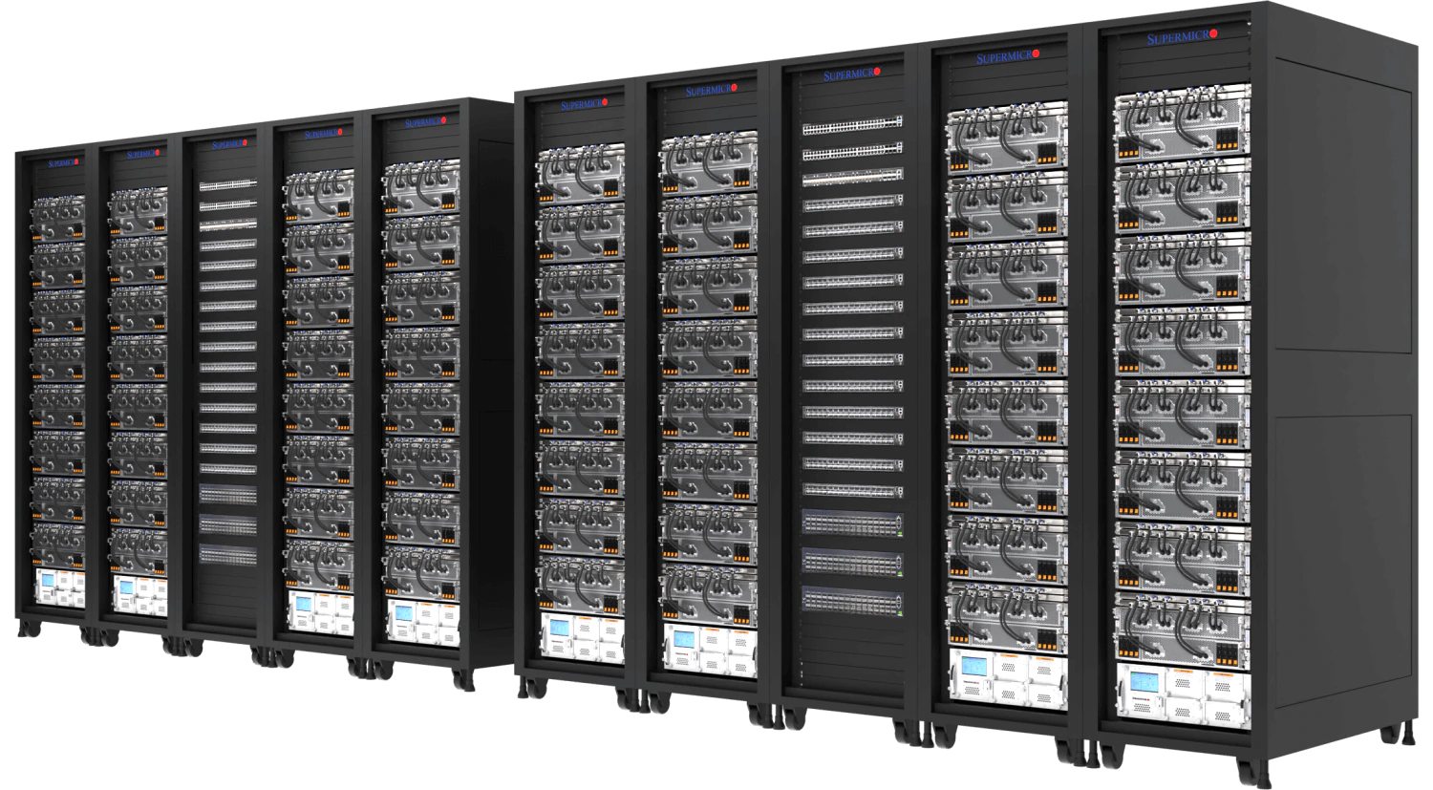
Alpine Partitions
COMPUTE
Notes:
Compute nodes are organized into partitions – logical groups of similarly spec’d hardware.
Partitions make it easier to request specific resources and ensure a more consistent user experience.
The Alpine Cluster has four primary partitions.
Detailed Information on Alpine Hardware: https://curc.readthedocs.io/en/latest/clusters/alpine/alpine-hardware.html

Slide 18
Alpine Partitions
amilan
General Usage
Notes:
amilan:
285 Nodes
64 CPU Cores per Node
3.75 GB of RAM per CPU (240 GB total)
Detailed Information on Alpine Hardware: https://curc.readthedocs.io/en/latest/clusters/alpine/alpine-hardware.html

Slide 19
Alpine Partitions
amilan
General Usage
amem
High Memory
Notes:
amem:
22 Nodes
48 CPU Cores per node (12)
64 CPU Cores per node (10)
21.5 GB of RAM per CPU (1 TB total)
Detailed Information on Alpine Hardware: https://curc.readthedocs.io/en/latest/clusters/alpine/alpine-hardware.html

Slide 20
Alpine Partitions
amilan
General Usage
aa100
Nvidia GPU’s
amem
High Memory
Notes:
aa100
12 Nodes
64 CPU Cores per Node
3.75 GB of RAM per CPU (240 GB total)
3 GPU’s per Node (Nvidia A100)

Slide 21
Alpine Partitions
amilan
General Usage
aa100
Nvidia GPU’s
amem
High Memory
ami100
AMD GPU’s
Notes:
ami100
8 Nodes
64 CPU Cores per Node
3.75 GB of RAM per CPU (240 GB total)
3 GPU’s per Node (AMD MI100)
Detailed Information on Alpine Hardware: https://curc.readthedocs.io/en/latest/clusters/alpine/alpine-hardware.html

Slide 22
Quality of Service (QoS)
QoS | Description | Max wall time | Max jobs/user | Max nodes/user
normal | Default QoS | 24 H | 1000 | 128
Notes:
The normal qos is the default qos for all submitted jobs

Slide 23
Quality of Service (QoS)
QoS | Description | Max wall time | Max jobs/user | Max nodes/user
normal | Default QoS | 24 H | 1000 | 128
long | For jobs needing longer wall times | 7 D | 200 | 20
Notes:
The long qos provides a subset of amilan nodes to run longer jobs.
Please note! The long qos has fewer resources than normal and may have a longer wait time in the queue.

Slide 24
Quality of Service (QoS)
QoS | Description | Max wall time | Max jobs/user | Max nodes/user
normal | Default QoS | 24 H | 1000 | 128
long | For jobs needing longer wall times | 7 D | 200 | 20
mem | High-memory jobs | 7 D | n/a | 12
Notes:
The mem qos is specifically for jobs that run on the amem partition.

Slide 25
Quality of Service (QoS)
QoS | Description | Max wall time | Max jobs/user | Max nodes/user
normal | Default QoS | 24 H | 1000 | 128
long | For jobs needing longer wall times | 7 D | 200 | 20
mem | High-memory jobs | 7 D | n/a | 12
testing | For jobs submitted to testing partitions | 1 H | 1 | n/a
Notes:
The testing qos supports the different testing partitions, ensuring that users can quickly access resources for testing their workflows. Keep in mind the stringent constraints – this partition is not intended for running regular jobs.

Slide 26


Batch vs Interactive
Batch
Job
Interactive
Job
Notes:
Now that you have a general idea of what resources you plan to request, you will need to consider the type of job you are wanting to schedule. A batch job or an interactive job.

Slide 27
Batch vs Interactive
Runs a job script
No need for user input
Best for tested workflows and long/big jobs
Batch
Job
Interactive
Job

Slide 28
Batch vs Interactive
Runs a job script
No need for user input
Best for tested workflows and long/big jobs
Terminal or GUI
Requires active user input
Best for development and exploration
Batch
Job
Interactive
Job

Slide 29
Interactive jobs
acompile
Quick access to resources
Limit of 4 CPUs for up to 12 hours
Focused on compiling/building software and small workflows
sinteractive
Request any partition, more resources, and longer walltime
Subject to standard wait times (not immediate access)
Focused on GUI-based software

Slide 30
Running an interactive job
Here we will run a Python script using an interactive job
First request resources:
When the job starts you will be put on a compute node and you can execute your commands:
To quit:
$ sinteractive --partition=atesting --qos=testing --time=00:10:00 --ntasks=1
$ module load anaconda
$ python my_very_cool_script.py
$ exit

Slide 31
Batch Jobs
Batch Jobs are jobs you submit to the scheduler that are run later without supervision
A job script is simply a script that includes SLURM directives (resource specifics) ahead of any commands.

Slide 32
Anatomy of a job script
#!/bin/bash
## Directives
#SBATCH --<option>=<value>
## Software
module load <software>
## User scripting
<command>

Slide 33
Anatomy of a job script
#!/bin/bash
## Directives
#SBATCH --<option>=<value>
## Software
module load <software>
## User scripting
<command>

Slide 34
Directives in a job script
#SBATCH --<option>=<value>

Slide 35
Common directives
Partition – A collection of compute nodes
--partition=<partition_name>
Quality of service (QoS) – System defined constraints for a job (more on this later!)
--qos=<qos>
Allocation – Account to “charge to”
--account=<account_name>
Number of nodes to run on
--nodes=<nodes>
Number of cores to run on
--ntasks=<number-of-tasks>

Slide 36
Common directives
Wall time – How long you want to run on these resources
--time=<wall time>
Job name
--job-name=<jobname>
Output – Where all output that would be written to the terminal should go
--output=<name>
Send an email when events happen in the job
--mail-type=<type>
Email address to send updates to
--mail-user=<user>

Slide 37
Example job script
#!/bin/bash
## Directives
#SBATCH --ntasks=1 # Number of requested tasks/cores
#SBATCH --time=0:01:00 # Max run time
#SBATCH --partition=amilan # Specify Alpine CPU node
#SBATCH --output=test_%j.out # Rename standard output file
## Software
module purge # Purge all existing modules
## User commands
echo "This is a test of user $USER"
Notes:
Output files are important for debugging and verifying a job has completed successfully. Always include a --output directive!
The output file is created in directory job was run unless specified in your --output directive.
If the directive --output is not provided, then a generic file name will be used (slurm_xxxxxx.out).

Slide 38
Software job script example
#!/bin/bash
## Directives
#SBATCH --ntasks=1 # Number of requested tasks/cores
#SBATCH --time=0:01:00 # Max run time
#SBATCH --partition=amilan # Specify Alpine CPU node
#SBATCH --output=test_%j.out # Rename standard output file
## Software
module purge # Purge all existing modules
module load anaconda # Load Anaconda
conda activate <my-conda-environment> # Activate CONDA environment
## Run Python script
python my_cool_script.py
Notes:
Software can be loaded using the software module system or by accessing user installed software in their /projects directory.
https://curc.readthedocs.io/en/latest/compute/modules.html
Be careful not to run GUI or other software that requires user interaction!

Slide 39
Submitting a Job script
sbatch <job_file> <other-directives>
Command to submit a job to the SLURM job scheduler

Slide 40
Submitting a Job script
sbatch <job_file> <other-directives>
Command to submit a job to the SLURM job scheduler
If we created the job script “my_first_job.sh” then we would submit it as follows:
sbatch /path/to/my_first_job.sh

Slide 41
Submitting a Job script
sbatch <job_file> <other-directives>
Command to submit a job to the SLURM job scheduler
If we created the job script “my_first_job.sh” then we would submit it as follows:
sbatch /path/to/my_first_job.sh
Modify slurm directives in the batch script:
sbatch /path/to/my_first_job.sh --ntasks=12

Slide 42
Checking your jobs
squeue: Monitor your jobs status in queue and while running:
By default, shows all jobs in queue can specify using:
sacct: Check back on usage statistics of previous Jobs
By default, only checks all jobs from the start of the current day can specify using:
$ squeue –u <username>
$ squeue –p <partition>
$ sacct –u <username>
$ sacct --start=MM/DD/YY –u <username>
$ sacct –j <job-id>

Slide 43
Checking your jobs
To check the percentage of CPU and memory usage of a job after it completes, use seff
To see general statistics for your submitted jobs, use jobstats
$ module load slurmtools
$ seff <job number>
$ module load slurmtools
$ jobstats <username> <# of days>

Slide 44
Thank you!
Documentation: curc.readthedocs.io/
Trainings with Center for Research Data and Digital Scholarship (CRDDS): https://www.colorado.edu/crdds/
Helpdesk: rc-help@colorado.edu
Consult Hours (Tuesday 12:00-1:00 in-person, Thursday 1:00-2:00 virtually)

Slide 45

Survey and feedback
https://tinyurl.com/curc-survey18

